Slide 1

JavaScript, Sixth Edition
Chapter 9
Managing State and Information Security

Slide 2
Objectives
When you complete this chapter, you will be able to:
Save state information with query strings, hidden form fields, and cookies
Describe JavaScript security issues and employ coding practices designed to address them
JavaScript, Sixth Edition

Slide 3
Understanding State Information
State information
  Information about individual visits to a Web site
HTTP original design: stateless
  No persistent data about site visits stored
Reasons for maintaining state information
  Customize individual web pages
  Store information within a multipart form
  Provide shopping carts
JavaScript, Sixth Edition

Slide 4
Saving State Information with Query Strings
Query string
  Set of name-value pairs
    Appended to a target URL
  Consists of a single text string
    Contains one or more pieces of information
Passes information from one web page to another
JavaScript, Sixth Edition

Slide 5
Saving State Information with Query Strings (cont’d.)
Passing data with a query string
  Add a question mark (?) immediately after a URL
    Followed by the query string (in name-value pairs) for the information to preserve
  Ampersands (&)
    Separates individual name-value pairs within the query string
  Example:
    <a href="http://www.example.com/↵
    addItem.html?isbn=9780394800165&quantity=2">Order Book</a>
JavaScript, Sixth Edition

Slide 6
Saving State Information with Query Strings (cont’d.)
  Passed query string assigned to target web page Location object search property
    search property of the Location object contains a URL’s query or search parameters
From preceding example:
  Query string
    "?isbn=9780394800165&quantity=2"
  Available as the value of the search property of the Location object
    After addItem.html document opens
JavaScript, Sixth Edition

Slide 7
Saving State Information with Query Strings (cont’d.)
Remove the question mark
  Using the substring() method combined with the length property
  Example:
  // Assign the query string to the queryData variable
  var queryData = location.search;
  // Remove the opening question mark from the string
  queryData = queryData.substring(1, queryData.length);
JavaScript, Sixth Edition

Slide 8
Saving State Information with Query Strings (cont’d.)
Convert individual pieces of information into array elements
  Using the split() method
  Example:
    Convert the information in the queryData variable into an array named queryArray[]
  // split queryData into an array
  var queryArray = queryData.split("&");
JavaScript, Sixth Edition

Slide 9
Saving State Information with Hidden Form Fields
Hidden form field
  Special type of form element
  Not displayed by web browser
  Allows information to be hidden from users
  Created with the input element
  Temporarily stores data sent to a server along with the rest of a form
  No need for user to see hidden data
Syntax
  <input type="hidden">
JavaScript, Sixth Edition

Slide 10
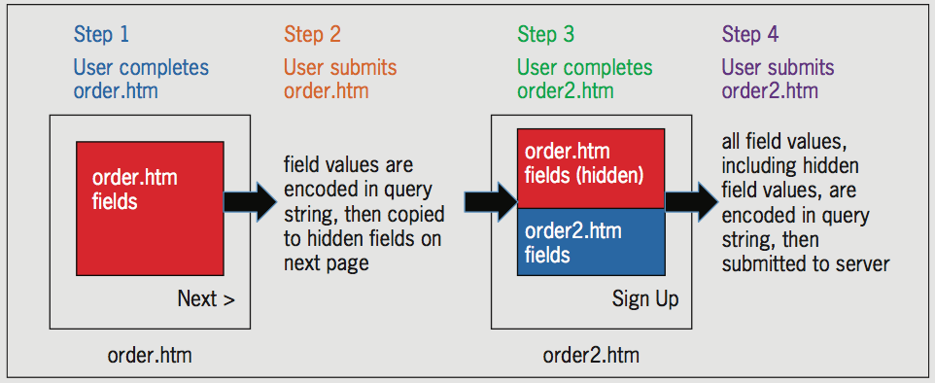
Saving State Information with Hidden Form Fields (cont’d.)
Figure 9-7 Submitting data from multiple forms using hidden fields
JavaScript, Sixth Edition

Slide 11
Saving State Information with Cookies
Query strings and hidden form fields temporarily maintain state information
Cookies
  Small pieces of information about a user
  Stored by a web server in text files
  Stored on the user’s computer
When Web client visits a web server
  Saved cookies sent from client to the server
Temporary cookies
  Available only for current browser session
JavaScript, Sixth Edition

Slide 12
Storing State Information
Query strings and hidden form fields temporarily maintain state information
Two methods of storing state information on user's computer
  cookies
  Web Storage
JavaScript, Sixth Edition

Slide 13
Storing State Information with Cookies
Cookies
  Small pieces of information
  Stored in text files
Temporary cookies
  Remain available only for current browser session
Persistent cookies
  Remain available beyond current browser session
    Stored in a text file on a client computer
JavaScript, Sixth Edition

Slide 14
Storing State Information with Cookies (cont'd.)
Limitations on the use of cookies
  Server or domain can store a maximum of 20 cookies
  Total cookies per browser cannot exceed 300
  Largest cookie size is 4 kilobytes
Not enforced by all browsers
JavaScript, Sixth Edition

Slide 15
Creating and Modifying Cookies
Use the cookie property of the Document object
  Creates cookies in name-value pairs
  Syntax
    document.cookie = name + "=" + value;
  Cookie property created with a required name attribute and four optional attributes:
    expires, path, domain, secure
JavaScript, Sixth Edition

Slide 16
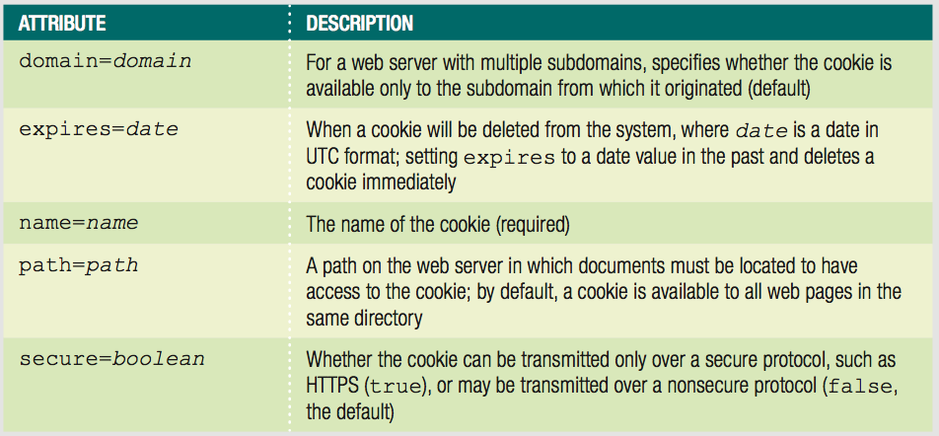
Creating and Modifying Cookies (cont’d.)
Table 9-1 Cookie attributes
JavaScript, Sixth Edition

Slide 17
Creating and Modifying Cookies (cont’d.)
name attribute
  Only required parameter
  Specifies cookie’s name-value pair
  Cookies created with only the name attribute:
    Temporary cookies
  cookie property adds another entry to a list of cookies
JavaScript, Sixth Edition

Slide 18
Creating and Modifying Cookies (cont’d.)
  Example: build a list of cookies
    document.cookie = "username=mw101";
    document.cookie = "member=true";
    document.cookie = "audio=false";
  Resulting value of cookie property:
    username=mw101; member=true; audio=false
JavaScript, Sixth Edition

Slide 19
Creating and Modifying Cookies (cont’d.)
  Cookies cannot include semicolons or special characters
    Can use special characters in cookies if using encoding
  Encoding involves converting special characters in a text string
    To corresponding hexadecimal ASCII value preceded by a percent sign
JavaScript, Sixth Edition

Slide 20
Creating and Modifying Cookies (cont’d.)
  encodeURIComponent() function
    Used for encoding the individual parts of a URI
    Converts special characters in the individual parts of a URI to corresponding hexadecimal ASCII value
    Syntax: encodeURIComponent(text)
  decodeURIComponent() function
    Counterpart of encodeURIComponent() function
    Syntax: decodeURIComponent(text)
JavaScript, Sixth Edition

Slide 21
Creating and Modifying Cookies (cont’d.)
Testing Applications That Use Cookies
  Browsers open local documents without HTTP
  Some browsers don't support setting cookies when HTTP protocol not used
  Can focus testing on browsers that support cookies on files opened without HTTP
  More robust option
    run local web server
    open files using HTTP protocol
    some code editors include built-in testing server
JavaScript, Sixth Edition

Slide 22
Creating and Modifying Cookies (cont’d.)
expires attribute
  Determines how long a cookie can remain on a client system before being deleted
  Cookies created without this attribute
    Available current browser session only
  Syntax: expires=date
    name-value pair and the expires=date pair separated by a semicolon
  Do not encode expires attribute
JavaScript, Sixth Edition

Slide 23
Creating and Modifying Cookies (cont’d.)
  Can manually type a string in UTC format or:
    Can create string with the Date object
  Use the toUTCString() method to convert the Date object to a string
  Example:
^{var expiresDate = new Date();}
var username = document.getElementById("username").value;
expiresDate.setFullYear(expiresDate.getFullYear() + 1);
document.cookie = "username=" +↵
encodeURIComponent(username) + "; expires=" +↵
^{expiresDate.toUTCString();}
JavaScript, Sixth Edition

Slide 24
Creating and Modifying Cookies (cont’d.)
Configuring availability of cookies to other web pages on the server
  use path attribute
    Default: cookie available to all web pages in the same directory
    To make cookie available to all directories on a server
      Use a slash
JavaScript, Sixth Edition

Slide 25
Creating and Modifying Cookies (cont’d.)
  Example:
    var username = document.getElementById("username").value;
    document.cookie = "username=" +↵
    encodeURIComponent(username + "; path=/advertising");
  Example:
    document.cookie = "username=" +↵
    encodeURIComponent(username + "; path=/");
  Cookies from other programs stored in the same directory
    Can cause JavaScript program to run erratically
JavaScript, Sixth Edition

Slide 26
Creating and Modifying Cookies (cont’d.)
Sharing cookies across a domain
  use domain attribute
    Example:
    var username = document.getElementById("username").value; document.cookie = "username=" +↵
    ^{encodeURIComponent(username +↵}
    ^{"; domain=.example.com");}
    Cannot share cookies outside of a domain
JavaScript, Sixth Edition

Slide 27
Creating and Modifying Cookies (cont’d.)
Securing cookie transmissions
  secure attribute
    Indicates cookie can only be transmitted across a secure Internet connection
      Using HTTPS or another security protocol
    Example:
    var username = document.getElementById("username").value; document.cookie = "username=" +↵
    encodeURIComponent(username + "; secure=true");
JavaScript, Sixth Edition

Slide 28
Reading Cookies with JavaScript
Parsing a cookie
  Decode it using decodeURIComponent() function
  Use the String object methods to extract individual name-value pairs
  Similar to parsing query strings
    Do not need to remove the question mark at the beginning of the string
    Individual cookies separated by a semicolon and a space instead of ampersands
JavaScript, Sixth Edition

Slide 29
Reading Cookies with JavaScript (cont’d.)
  Example:
    Create three encoded cookies
    Read them from the cookie property, decode them
    Use the split() method to copy each name-value pair into cookieArray[] array elements
    Determine which cookie holds needed value
      for loop to cycle through array elements
      if statement to check name portion of each name-value pair
JavaScript, Sixth Edition

Slide 30
Reading Cookies with JavaScript (cont’d.)
document.cookie = "username=" +↵
^{encodeURIComponent(username);}
^{document.cookie = "member=" +↵}
^{encodeURIComponent(member);}
^{document.cookie = "audio=" +↵}
^{encodeURIComponent(audio);}
var cookieString = decodeURIComponent(document.cookie);
var cookieArray = cookieString.split("; ");
JavaScript, Sixth Edition

Slide 31
Reading Cookies with JavaScript (cont’d.)
^{var currentUsername;}
var unBox = document.getElementById("username");
^{for (var i = 0; i < 3; i++) {}
currentUsername = cookieArray[i];
^{if↵}
(currentUsername.substring(0,currentUsername.indexOf("="))↵
^{=== "username") {}
^{unBox.value =↵}
currentUsername.substring(currentUsername.↵
indexOf("=") + 1,currentUsername.length);
^{break;}
}
}
JavaScript, Sixth Edition

Slide 32
Deleting Cookies with JavaScript
Not intuitive
  Must set cookie expiration to a date in the past
Example:
  Delete username cookie by setting its expires attribute to one week ago
    ^{var expiresDate = new Date();}
    var username = document.getElementById("username").value;
    expiresDate.setDate(expiresDate.getDate() - 7);
    document.cookie = "username=" +↵
    encodeURIComponent(username) + "; expires=" +↵
    ^{expiresDate.toUTCString();}
JavaScript, Sixth Edition

Slide 33
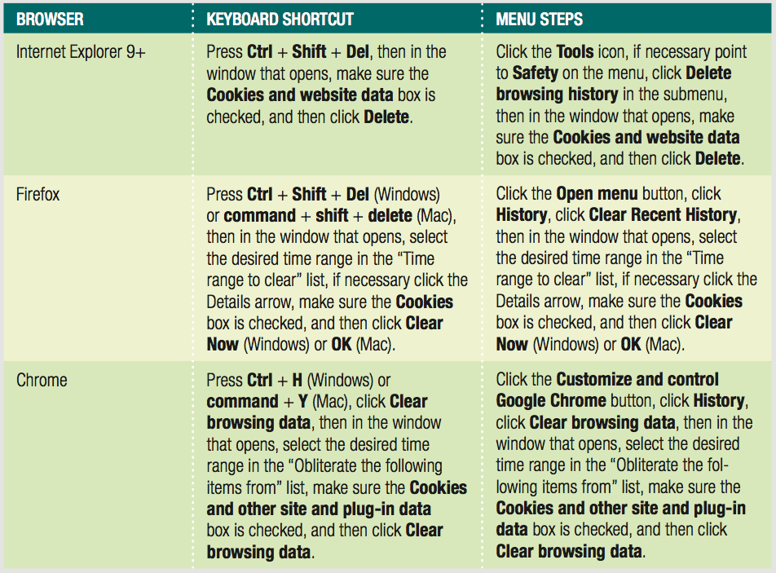
Deleting Cookies from Your Browser
Persistent cookies can interfere with testing
Good idea to delete cookies periodically
Table 9-2 Steps to delete cookies in IE, Firefox, and Chrome
JavaScript, Sixth Edition

Slide 34
Storing State Information with the Web Storage API
Common uses of cookies never originally planned
Web Storage
  Draft specification of W3C
  Not supported by some older browsers
  Cookies are still the standard
  Web Storage offers additional features
  Applications targeted at specific browsers can use Web Storage
JavaScript, Sixth Edition

Slide 35
Storing State Information with the Web Storage API (cont'd.)
Two Web Storage properties of Window object
  localStorage
    Remains until you run code to delete it
    Similar to persistent cookies
  sessionStorage
    Removed automatically when user closes browser tab or window
    Like temporary cookies
JavaScript, Sixth Edition

Slide 36
Storing State Information with the Web Storage API (cont'd.)
Storing/reading Web Storage easier than cookies
  Example:
  var firstName = document.getElementById("fname").value;
  localStorage.fName = firstName;
To use a method
  Preface it with localStorage or sessionStorage
JavaScript, Sixth Edition

Slide 37
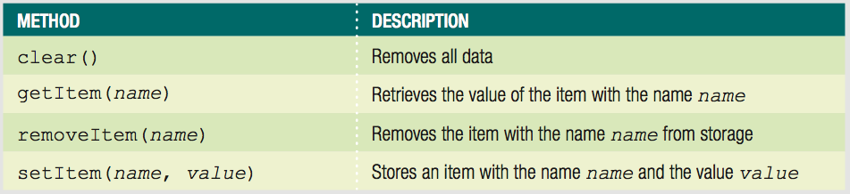
Storing State Information with the Web Storage API (cont'd.)
Table 9-3 Methods of the Web Storage API
JavaScript, Sixth Edition

Slide 38
Understanding Security Issues
Security threats
  Viruses, worms, data theft by hackers
Consider web server security and secure coding issues
Web server security technologies
  Firewalls
  Secure Socket Layer (SSL)
JavaScript programs downloaded and execute locally
JavaScript, Sixth Edition

Slide 39
Secure Coding with JavaScript
Secure coding or defensive coding
  Writing code to minimize any intentional or accidental security issues
All code: insecure unless proven otherwise
No magic formula for writing secure code
JavaScript, Sixth Edition

Slide 40
JavaScript Security Concerns
Security areas of most concern:
  Protection of a web page and JavaScript program against malicious tampering
  Privacy of individual client information
  Protection of the local file system of the client or web site from theft or tampering
Code injection attack
  Program or user enters JavaScript code that changes function of web page
    Validating forms helps prevent this
    Escaping characters also important
JavaScript, Sixth Edition

Slide 41
JavaScript Security Concerns
Another security concern
  Privacy of individual client information in the web browser window
Important JavaScript security feature
  Lack of certain types of functionality
    File manipulation
    Create a network connection
    Cannot run system commands or execute programs on a client
JavaScript, Sixth Edition

Slide 42
The Same Origin Policy
Restricts how JavaScript code access between windows/tabs/frames
To view and modify elements in other windows and frames
  They must have the same protocol and exist on the same web server
Same origin policy applies to:
  The domain name
  The server on which a document located
JavaScript, Sixth Edition

Slide 43
The Same Origin Policy (cont’d.)
Policy prevents:
  Malicious scripts from modifying content of other windows and frames
  Theft of private browser information and information displayed on secure web pages
Policy protects integrity of web page design
JavaScript, Sixth Edition

Slide 44
The Same Origin Policy (cont’d.)
domain property of the Document object
  Changes origin of a document to its root domain name
  Allows documents from different origins in the same domain to access each other’s elements and properties
JavaScript, Sixth Edition

Slide 45
Using Third-Party Scripts
Sometimes you want to run scripts from other domains
  Known as third-party scripts
  Examples:
    Widgets that run from provider's server
    Using Content Delivery Network (CDN)
To enable third-party script
  Include script element with src value pointing to third-party content
  Exception to same origin policy
JavaScript, Sixth Edition

Slide 46
Summary
State information
  Information about individual visits to a web site
HTTP originally designed to be stateless
Most common tools for maintaining state information:
  Query strings, hidden form fields, cookies, Web Storage
Query string
  Set of name-value pairs appended to a target URL
Can hide information from users in a hidden form field
JavaScript, Sixth Edition

Slide 47
Summary (cont’d.)
Cookies
  Small pieces of information about a user
  Stored by a web server
  Can be temporary or persistent
Cookie property created with a required name attribute
Can use special characters in cookies if using encoding
encodeURIComponent() function encodes the individual parts of a URI
JavaScript, Sixth Edition

Slide 48
Summary (cont’d.)
When reading a cookie or other text string encoded
  Must first decode it with the decodeURIComponent() function
Cookies: one continuous string that must be parsed
Web Storage similar to cookies
  Offers more features, but not as widely supported
“Secure coding” or “defensive coding”
  Writing code to minimize any intentional or accidental security issues
JavaScript, Sixth Edition

